Slide 1
Lecture # 12
Nondeterministic Finite Automata
Examples of NFA
NFA- ∧
Examples of NFA- ∧

Slide 2
Nondeterministic Finite Automaton (NFA)
Definition
An NFA is a TG with a unique start state and a property of having single letter as label of transitions. An NFA is a collection of three things
Finite many states with one initial and some final states
Finite set of input letters, say, Σ = {a, b, c}
Finite set of transitions, showing where to move if a letter is input at certain state (∧ is not a valid transition), there may be more than one transition for certain letters and there may not be any transition for certain letters.

Slide 3
Observations
It may be observed, from the definition of NFA, that the string is supposed to be accepted, if there exists at least one successful path, otherwise rejected.
It is to be noted that an NFA can be considered to be an intermediate structure between FA and TG.

Slide 4
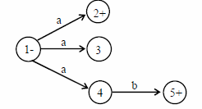

Example
It is to be noted that the above NFA accepts the language of strings, defined over Σ = {a, b}, containing aa.
It is to be noted that the above NFA accepts the language consisting of a and ab.

Slide 5
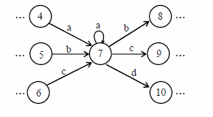
Note
It is to be noted that NFA helps to eliminate a loop at certain state of an FA. This process is done converting the loop into a circuit. But during this process the FA remains no longer FA and is converted to a corresponding NFA, which is shown in the following example.
Example: Consider a part of the following FA with an alphabet Σ = {a,b,c,d}

Slide 6
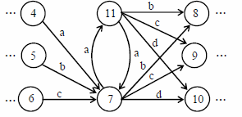
To eliminate the loop at state 7, the corresponding NFA may be as follows
Make the twin state which has loop, and make the circuit of the loop letter.
Inward transitions should be marked on any one of the twin states.
Outward transitions should be marked on both the states.

Slide 7
NFA with Null String
Definition
If in an NFA, ∧ is allowed to be a label of an edge then the NFA is called NFA with ∧ (NFA-∧). An NFA-∧ is a collection of three things
Finite many states with one initial and some final states.
Finite set of input letters, say, Σ = {a, b, c}.
Finite set of transitions, showing where to move if a letter is input at certain state.
There may be more than one transitions for certain letter and there may not be any transition for a certain letter. The transition of ∧ is also allowed at any state.

Slide 8


Example
Consider the following NFA with Null string
The above NFA with Null string accepts the language of strings, defined over Σ = {a, b}, ending in b.
Consider the following NFA with Null string
The above NFA with Null string accepts the language of strings, defined over Σ = {a, b}, ending in a.

Slide 9
Note
It is to be noted that every FA may be considered to be an NFA-∧ as well, but the converse may not true. Similarly every NFA-∧ may be considered to be a TG as well, but the converse may not true.

